Slide 1
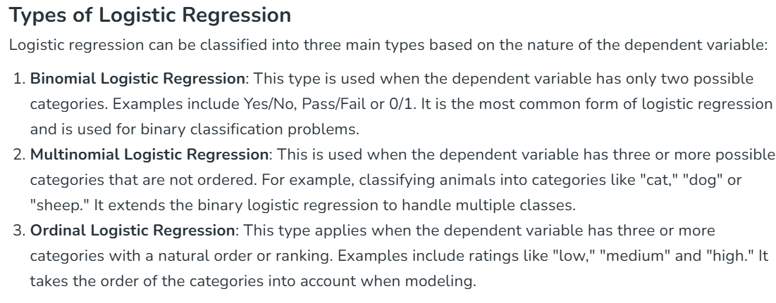
Logistic Regression in Machine Learning
Logistic Regression is a supervised machine learning algorithm used for classification problems. Unlike linear regression which predicts continuous values it predicts the probability that an input belongs to a specific class.
It is used for binary classification where the output can be one of two possible categories such as Yes/No, True/False or 0/1.
It uses sigmoid function to convert inputs into a probability value between 0 and 1.

Slide 2
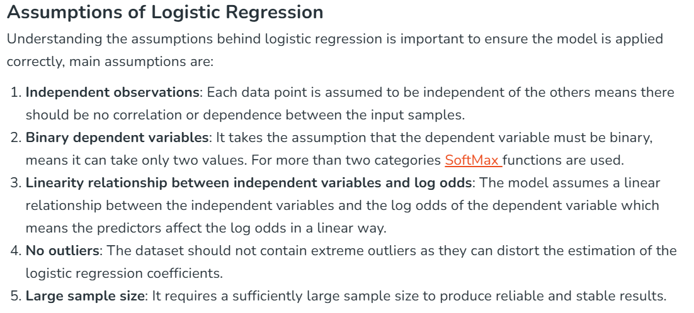

Slide 3
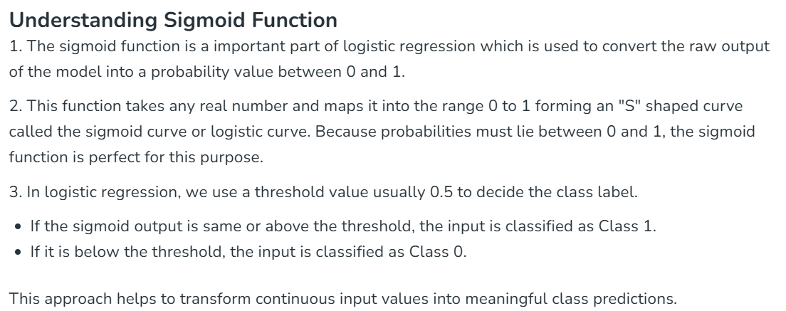

Slide 4
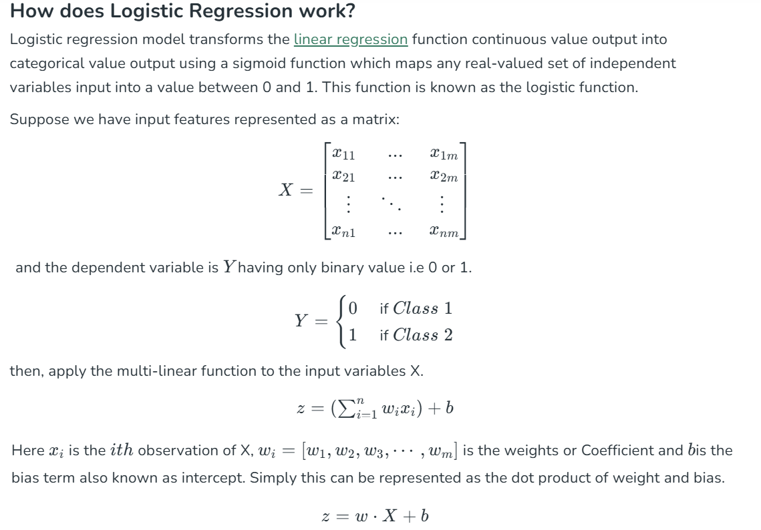

Slide 5
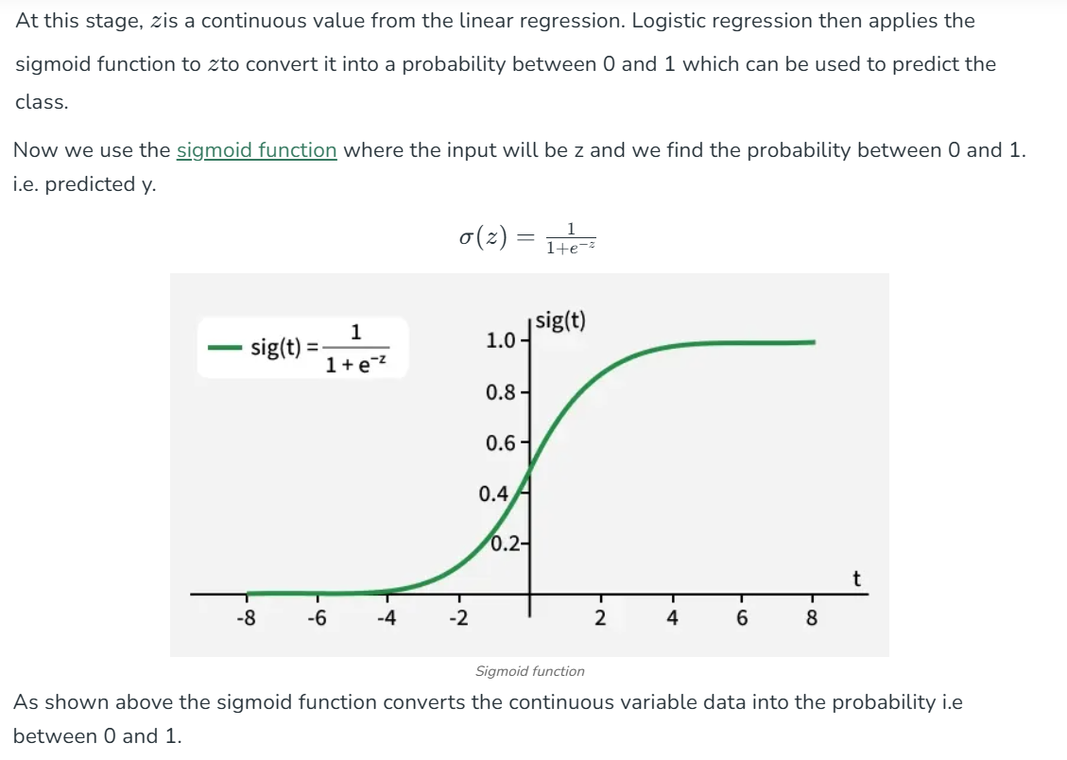

Slide 6
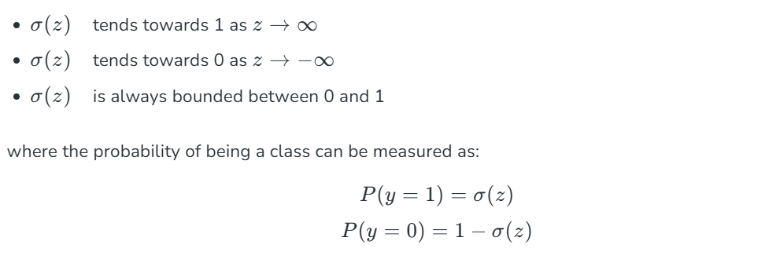

Slide 7
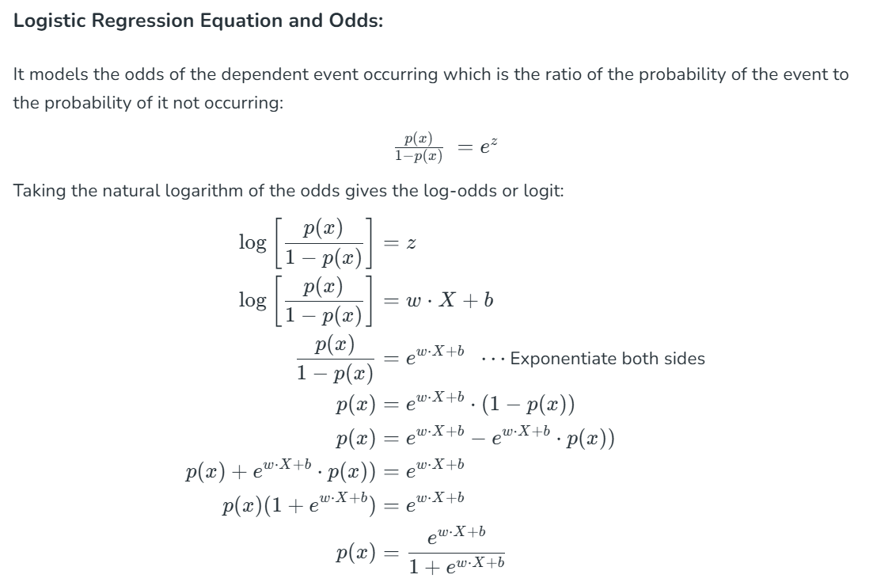

Slide 8
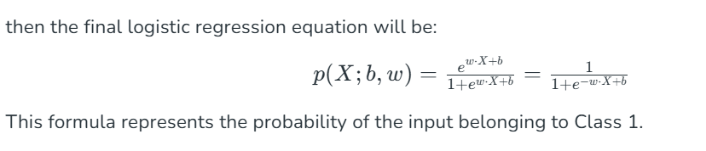
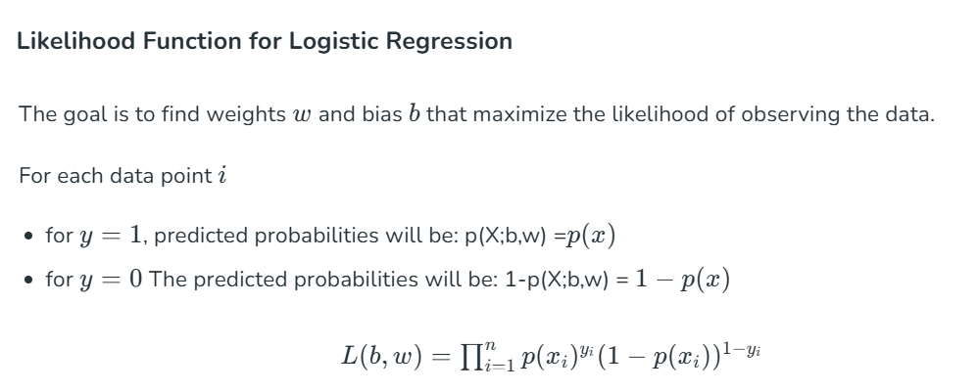

Slide 9
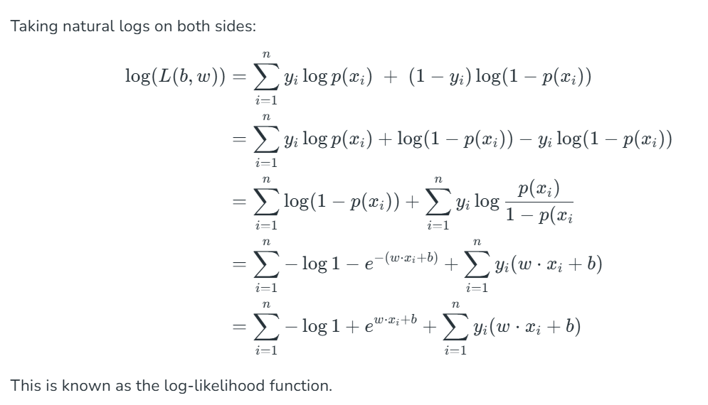

Slide 10
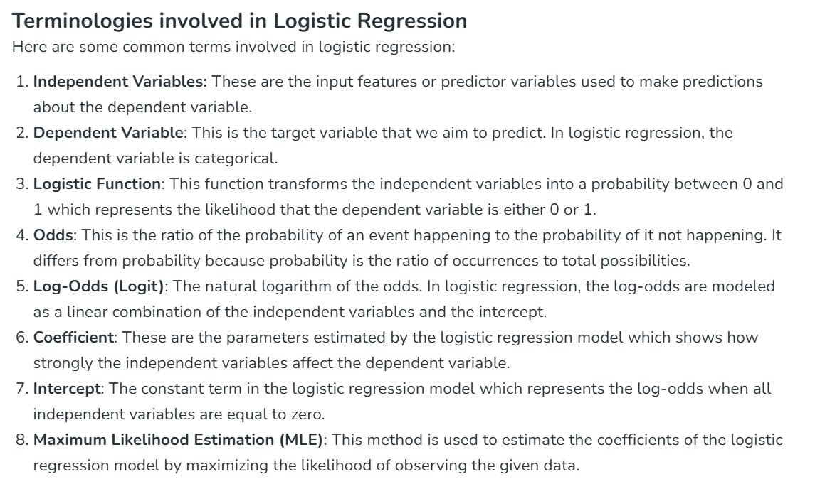

Slide 11
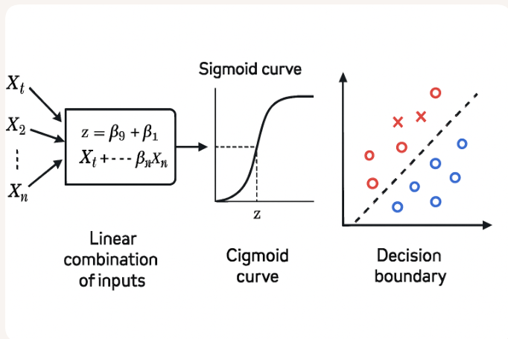

Slide 12
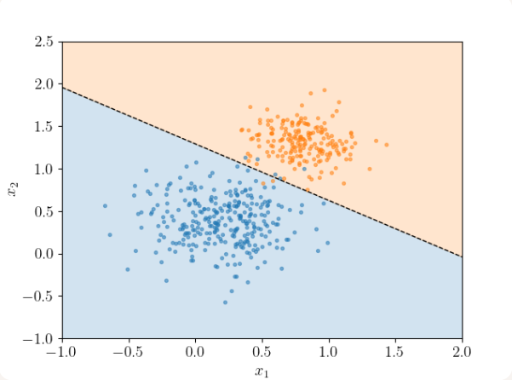

Slide 13
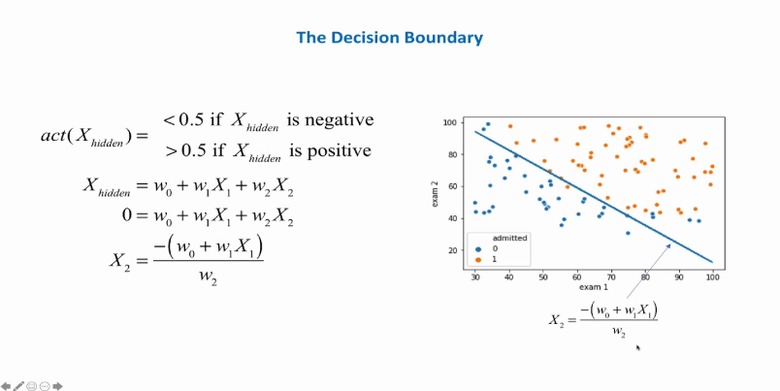

Slide 14
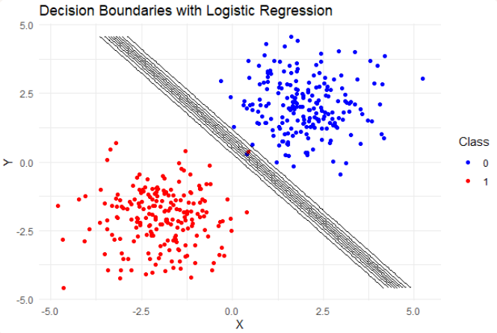

Slide 15
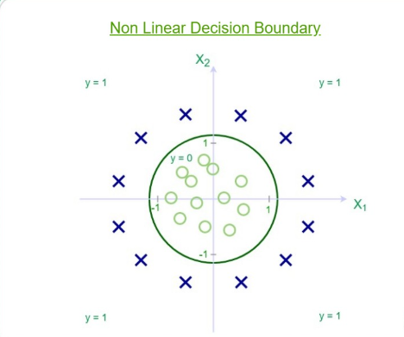

Slide 16
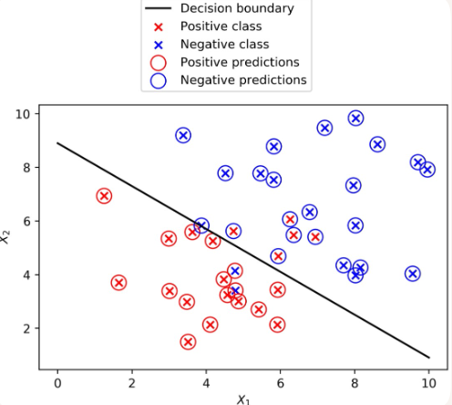
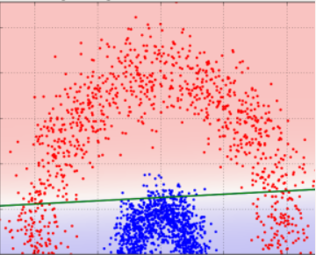

Slide 17
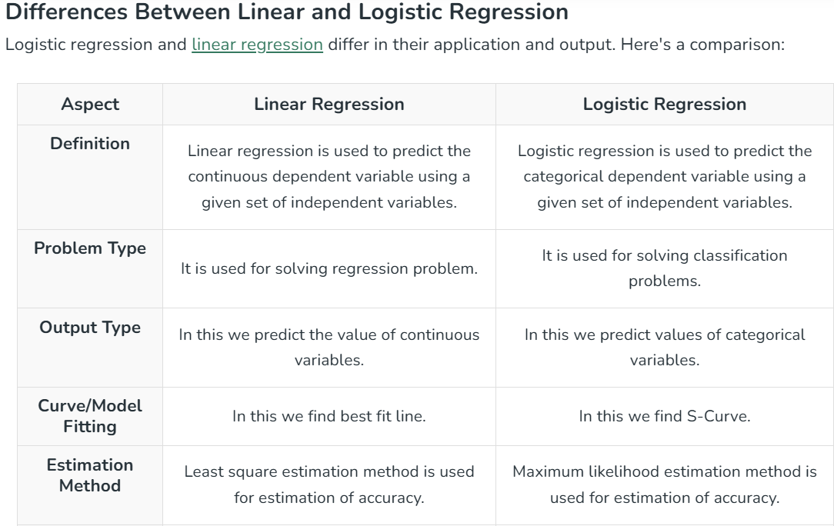

Slide 18
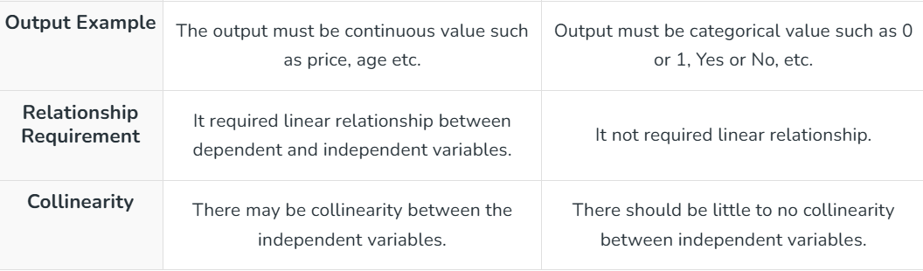

Slide 19
Practical Example
Use Case: Customer Churn Prediction
Scenario: A telecom company wants to predict if a customer will leave.
Features: Monthly charges, contract type, tenure, customer service calls.
Output: Probability of churn (e.g., 0.78 → likely to churn).
Action: Offer retention incentives to high-risk customers.
Advantages (Pros)
✅ Easy to implement and interpret
✅ Computationally efficient
✅ Works well for linearly separable data
✅ Outputs probabilities, not just class labels
✅ Can be extended to multiclass problems (multinomial logistic regression)
Disadvantages (Cons)
❌ Assumes linear relationship between features and log-odds
❌ Struggles with non-linear decision boundaries
❌ Sensitive to multicollinearity
❌ Can overfit in high-dimensional datasets
❌ Requires large sample size for stable estimates

Slide 20
Limitations
Linearity Assumption: Real-world data often has non-linear patterns
Outlier Sensitivity: Outliers can distort coefficients
Feature Engineering Dependency: Performance heavily depends on input features
Binary Focus: Standard logistic regression is for binary classification only.
Overcoming Limitations
Non-linearity: Use polynomial features or switch to non-linear models (e.g., decision trees, SVMs)
Multicollinearity: Apply dimensionality reduction (PCA) or remove correlated features
Overfitting: Use regularization (L1/Lasso, L2/Ridge)
Small Data: Collect more data or use bootstrapping techniques
Multi-class Problems: Use multinomial or one-vs-rest logistic regression

